Slide 1
Example of recursion tree
Solve T(n) = T(n/4) + T(n/2) + n²:

Slide 2
Example of recursion tree
Solve T(n) = T(n/4) + T(n/2) + n²:
T(n)

Slide 3
Example of recursion tree
Solve T(n) = T(n/4) + T(n/2) + n²:
n²
T(n/4)
T(n/2)

Slide 4
Example of recursion tree
Solve T(n) = T(n/4) + T(n/2) + n²:
n²
(n/4)²
(n/2)²
T(n/16)
T(n/8)
T(n/8)
T(n/4)

Slide 5
Example of recursion tree
Solve T(n) = T(n/4) + T(n/2) + n²:
n²
(n/4)²
(n/2)²
(n/16)²
(n/8)²
(n/8)²
(n/4)²
…
Θ(1)

Slide 6
Example of recursion tree
Solve T(n) = T(n/4) + T(n/2) + n²:
n²
(n/4)²
(n/2)²
(n/16)²
(n/8)²
(n/8)²
(n/4)²
…
Θ(1)

Slide 7
Example of recursion tree
Solve T(n) = T(n/4) + T(n/2) + n²:
n²
(n/4)²
(n/2)²
(n/16)²
(n/8)²
(n/8)²
(n/4)²
…
Θ(1)

Slide 8
Example of recursion tree
Solve T(n) = T(n/4) + T(n/2) + n²:
n²
(n/4)²
(n/2)²
(n/16)²
(n/8)²
(n/8)²
(n/4)²
…
…
Θ(1)

Slide 9
Example of recursion tree
Solve T(n) = T(n/4) + T(n/2) + n²:
n²
(n/4)²
(n/2)²
(n/16)²
(n/8)²
(n/8)²
(n/4)²
…
…
Θ(1)
Total =
= Θ(n²)
geometric series

Slide 10
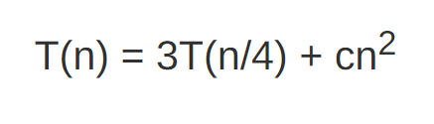

Slide 11



T(n)
$$\frac{n}{4}$$
$$\frac{n}{4}$$
$$\frac{n}{4}$$

Slide 12



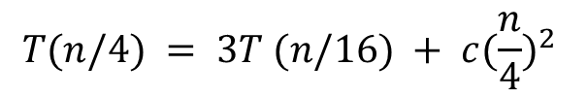
T(n)
$$\frac{n}{4}$$
$$\frac{n}{4}$$
$$\frac{n}{4}$$
$$\frac{n}{16}$$
$$\frac{n}{16}$$
$$\frac{n}{16}$$
$$T(n/4) = 3T (n/16) + c{(\frac{n}{4})}^{2}$$

Slide 13






T(n)
$$\frac{n}{4}$$
$$\frac{n}{4}$$
$$\frac{n}{4}$$
$$\frac{n}{16}$$
$$\frac{n}{16}$$
$$\frac{n}{16}$$
$$\frac{n}{16}$$
$$\frac{n}{16}$$
$$\frac{n}{16}$$
$$\frac{n}{16}$$
$$\frac{n}{16}$$
$$\frac{n}{16}$$
$$T(n/4) = 3T (n/16) + c{(\frac{n}{4})}^{2}$$

Slide 14

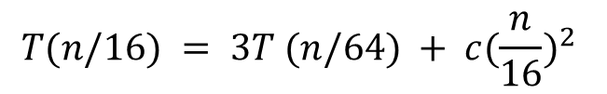





T(n)
$$\frac{n}{4}$$
$$\frac{n}{4}$$
$$\frac{n}{4}$$
$$\frac{n}{16}$$
$$\frac{n}{16}$$
$$\frac{n}{16}$$
$$\frac{n}{16}$$
$$\frac{n}{16}$$
$$\frac{n}{16}$$
$$\frac{n}{16}$$
$$\frac{n}{16}$$
$$\frac{n}{16}$$
$$\frac{n}{64}$$
$$\frac{n}{64}$$
$$\frac{n}{64}$$
$$\frac{n}{64}$$
$$\frac{n}{64}$$
$$\frac{n}{64}$$
$$T(n/16) = 3T (n/64) + c{(\frac{n}{16})}^{2}$$

Slide 15






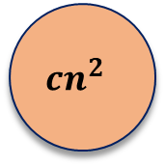

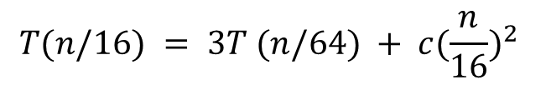





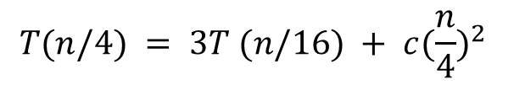



$${cn}^{2}$$
$$c{(\frac{n}{4})}^{2}$$
$$c{(\frac{n}{4})}^{2}$$
$$c{(\frac{n}{4})}^{2}$$
$$c{(\frac{n}{16})}^{2}$$
$$c{(\frac{n}{16})}^{2}$$
$$c{(\frac{n}{16})}^{2}$$
$$c{(\frac{n}{16})}^{2}$$
$$c{(\frac{n}{16})}^{2}$$
$$c{(\frac{n}{16})}^{2}$$
$$c{(\frac{n}{16})}^{2}$$
$$c{(\frac{n}{16})}^{2}$$
$$c{(\frac{n}{16})}^{2}$$
$$c{(\frac{n}{64})}^{2}$$
$$c{(\frac{n}{64})}^{2}$$
$$c{(\frac{n}{64})}^{2}$$
$$T(n/4) = 3T (n/16) + c{(\frac{n}{4})}^{2}$$
$$T(n/16) = 3T (n/64) + c{(\frac{n}{16})}^{2}$$

Slide 16
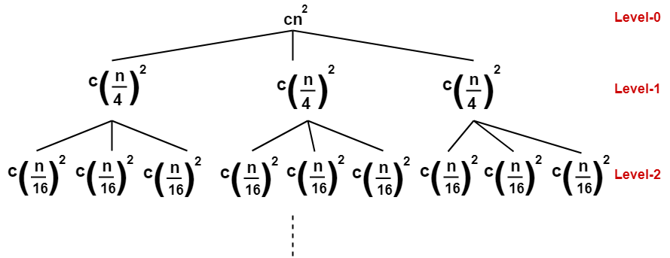

Slide 17
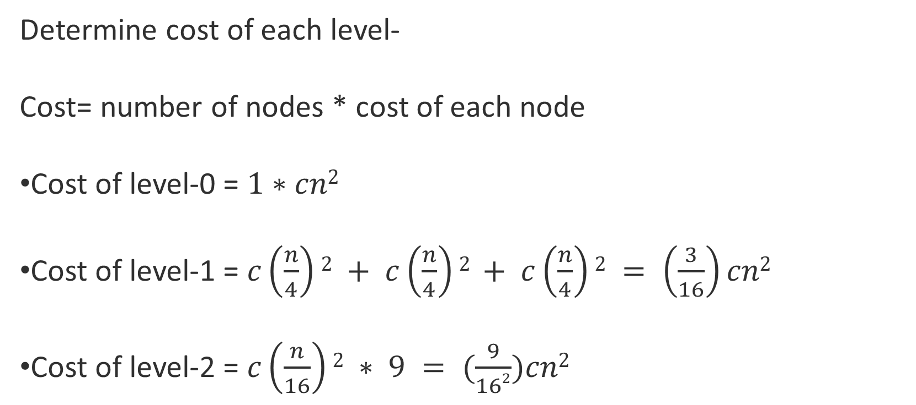
Determine cost of each level-
Cost= number of nodes * cost of each node
Cost of level-0 = $1∗cn2$
Cost of level-1 = $c\left(\frac{n}{4}\right)2 + c\left(\frac{n}{4}\right)2 + c\left(\frac{n}{4}\right)2 = \left(\frac{3}{16}\right)cn2$
Cost of level-2 = $c\left(\frac{n}{16}\right)2 ∗ 9 = (\frac{9}{162})cn2$

Slide 18
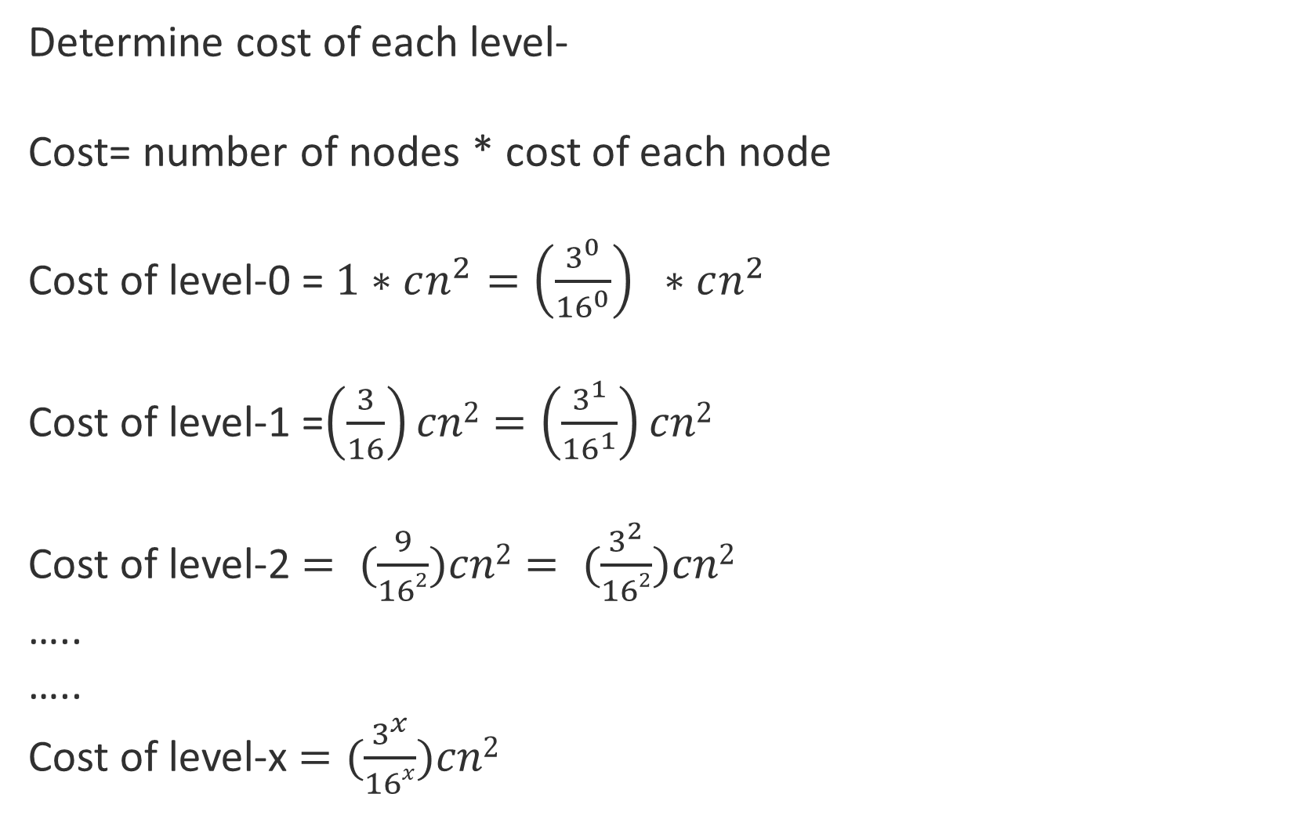
Determine cost of each level-
Cost= number of nodes * cost of each node
Cost of level-0 = $1∗cn^{2}={\left(\frac{3^{0}}{{16}^{0}}\right)}^{ } ∗cn^{2}$
Cost of level-1 =$\left(\frac{3}{16}\right)cn2=\left(\frac{3^{1}}{{16}^{1}}\right)cn2$
Cost of level-2 $= (\frac{9}{162})cn2= (\frac{3^{2}}{162})cn2$
…..
…..
Cost of level-x $=(\frac{3^{x}}{16x})cn2$

Slide 19
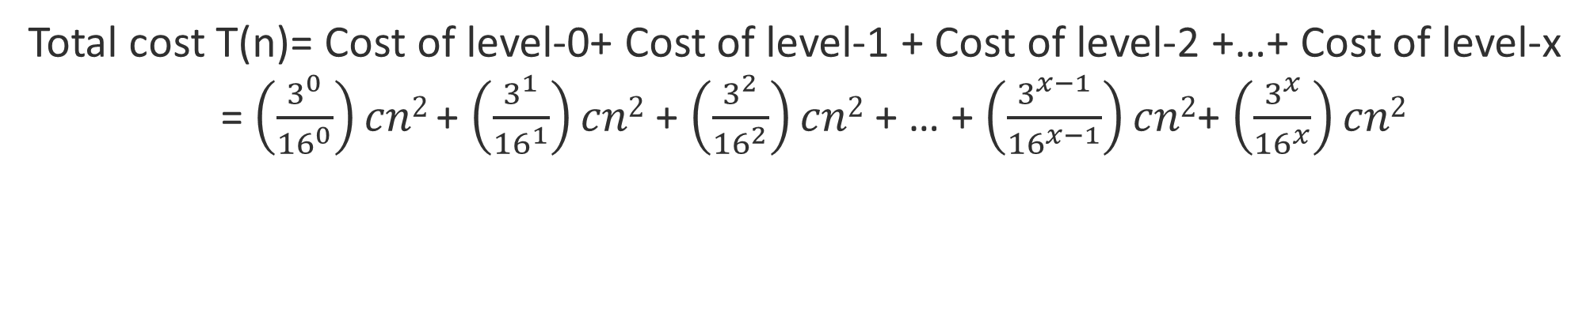
Total cost T(n)= Cost of level-0+ Cost of level-1 + Cost of level-2 +…+ Cost of level-x
= $\left(\frac{3^{0}}{{16}^{0}}\right)cn2$+ $\left(\frac{3^{1}}{{16}^{1}}\right)cn2$ + $\left(\frac{3^{2}}{{16}^{2}}\right)cn2$ + … + $\left(\frac{3^{x−1}}{{16}^{x−1}}\right)cn2$+ $\left(\frac{3^{x}}{{16}^{x}}\right)cn2$

Slide 20
T(n)
$$\frac{n}{4}$$
$$\frac{n}{4}$$
$$\frac{n}{4}$$
$$\frac{n}{16}$$
$$\frac{n}{16}$$
$$\frac{n}{16}$$
$$\frac{n}{16}$$
$$\frac{n}{16}$$
$$\frac{n}{16}$$
$$\frac{n}{16}$$
$$\frac{n}{16}$$
$$\frac{n}{16}$$
$$\frac{n}{64}$$
$$\frac{n}{64}$$
$$\frac{n}{64}$$
$$\frac{n}{64}$$
$$\frac{n}{64}$$
$$\frac{n}{64}$$

Slide 21
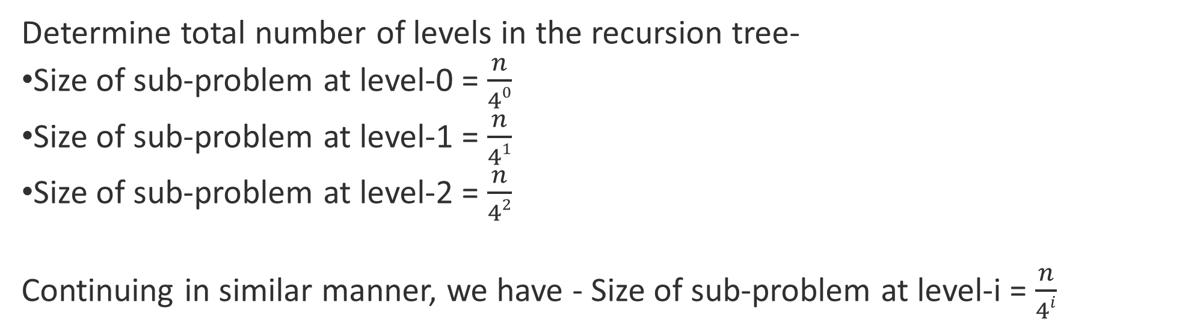
Determine total number of levels in the recursion tree-
Size of sub-problem at level-0 = $\frac{n}{40}$
Size of sub-problem at level-1 = $\frac{n}{41}$
Size of sub-problem at level-2 = $\frac{n}{42}$
Continuing in similar manner, we have - Size of sub-problem at level-i = $\frac{n}{4i}$

Slide 22
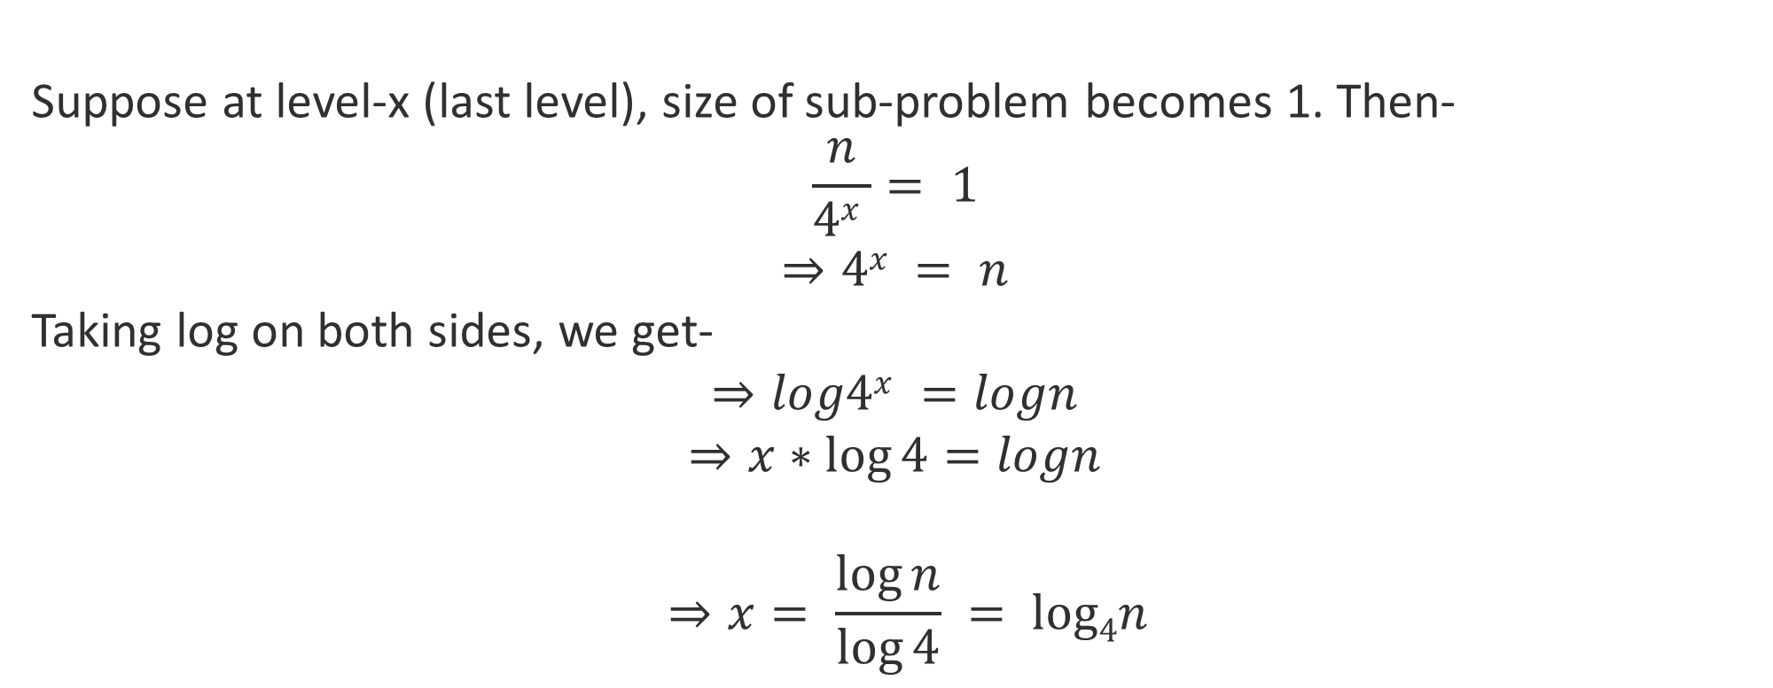
Suppose at level-x (last level), size of sub-problem becomes 1. Then-
$$\frac{n}{4x }= 1$$
$$⇒4x = n$$
Taking log on both sides, we get-
$$⇒log4x =logn$$
$$⇒x∗\log{4=logn}$$
$${⇒x= \frac{\log{n}}{\log{4}} }= log4n$$

Slide 23
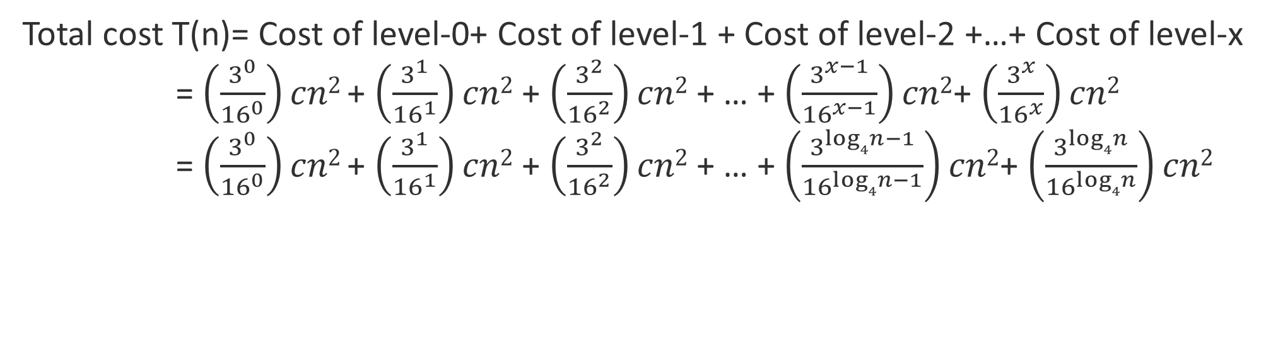
Total cost T(n)= Cost of level-0+ Cost of level-1 + Cost of level-2 +…+ Cost of level-x
= $\left(\frac{3^{0}}{{16}^{0}}\right)cn2$+ $\left(\frac{3^{1}}{{16}^{1}}\right)cn2$ + $\left(\frac{3^{2}}{{16}^{2}}\right)cn2$ + … + $\left(\frac{3^{x−1}}{{16}^{x−1}}\right)cn2$+ $\left(\frac{3^{x}}{{16}^{x}}\right)cn2$
= $\left(\frac{3^{0}}{{16}^{0}}\right)cn2$+ $\left(\frac{3^{1}}{{16}^{1}}\right)cn2$ + $\left(\frac{3^{2}}{{16}^{2}}\right)cn2$ + … + $\left(\frac{3^{log4n−1}}{{16}^{log4n−1}}\right)cn2$+ $\left(\frac{3^{log4n}}{{16}^{log4n}}\right)cn2$

Slide 24
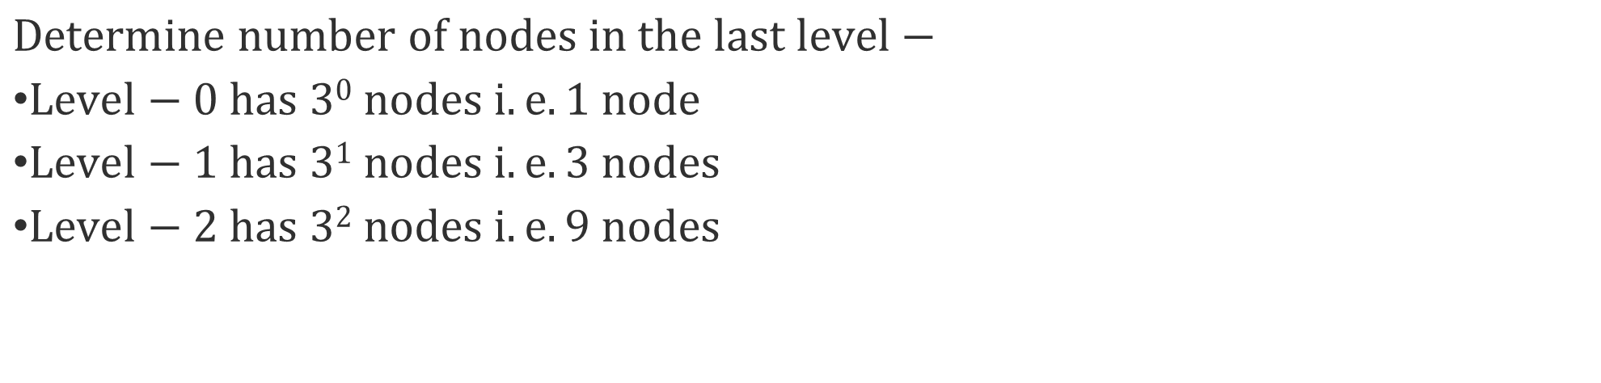
$$Determine number of nodes in the last level−$$
$Level−0 has 30 nodes i.e. 1 node$
$Level−1 has 31 nodes i.e. 3 nodes$
$Level−2 has 32 nodes i.e. 9 nodes$

Slide 25
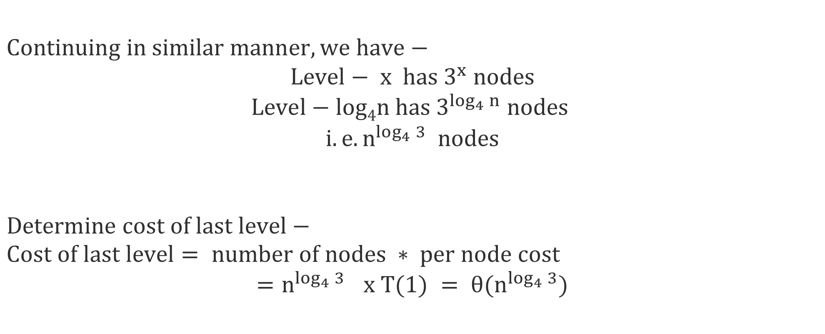
$$Continuing in similar manner, we have−$$
$$Level− x has 3^{x} nodes$$
$$Level−log4n has 3^{\log_{4}{n}} nodes$$
$$i.e. n^{\log_{4}{3}} nodes$$
$$Determine cost of last level−$$
$$Cost of last level= number of nodes ∗ per node cost$$
$${=n}^{\log_{4}{3}} x T(1) = θ(n^{\log_{4}{3}})$$

Slide 26
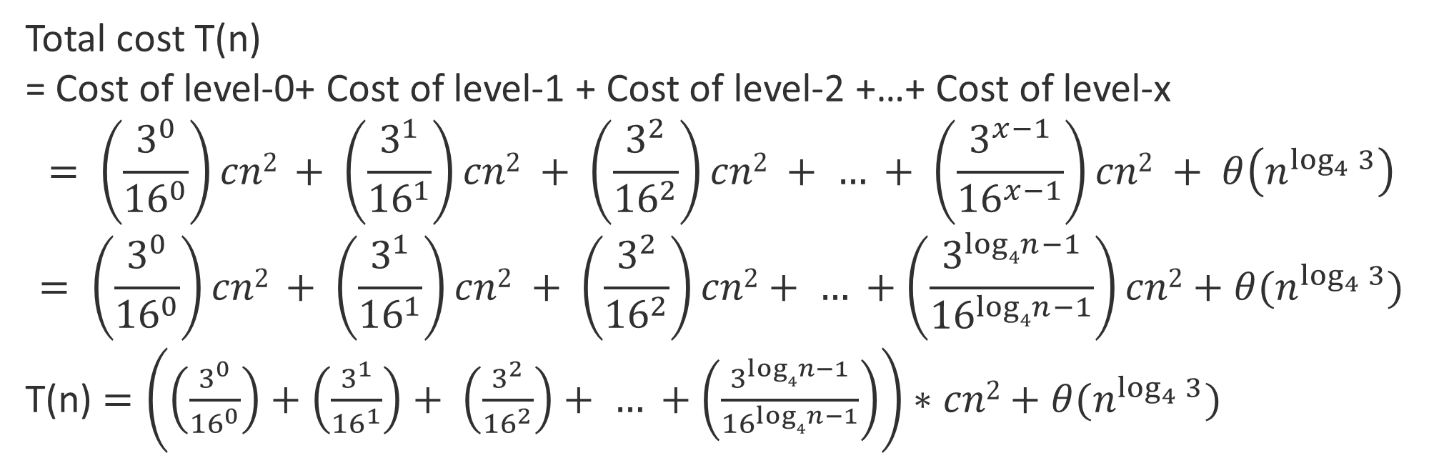
Total cost T(n)
= Cost of level-0+ Cost of level-1 + Cost of level-2 +…+ Cost of level-x
$$= \left(\frac{3^{0}}{{16}^{0}}\right)cn2 + \left(\frac{3^{1}}{{16}^{1}}\right)cn2 + \left(\frac{3^{2}}{{16}^{2}}\right)cn2 + … + \left(\frac{3^{x−1}}{{16}^{x−1}}\right)cn2 + θ\left(n^{\log_{4}{3}}\right)$$
$$= \left(\frac{3^{0}}{{16}^{0}}\right)cn2 + \left(\frac{3^{1}}{{16}^{1}}\right)cn2 + \left(\frac{3^{2}}{{16}^{2}}\right)cn2+ … +\left(\frac{3^{log4n−1}}{{16}^{log4n−1}}\right)cn2+θ(n^{\log_{4}{3}})$$
T(n) $=\left(\left(\frac{3^{0}}{{16}^{0}}\right)+\left(\frac{3^{1}}{{16}^{1}}\right)+ \left(\frac{3^{2}}{{16}^{2}}\right)+ … +\left(\frac{3^{log4n−1}}{{16}^{log4n−1}}\right)\right)∗cn2+θ(n^{\log_{4}{3}})$

Slide 27

$$T(n) =\left(\left(\frac{3^{0}}{{16}^{0}}\right)+\left(\frac{3^{1}}{{16}^{1}}\right)+ \left(\frac{3^{2}}{{16}^{2}}\right)+ … +\left(\frac{3^{log4n−1}}{{16}^{log4n−1}}\right)\right)∗cn2+θ(n^{\log_{4}{3}})$$
$\left(\frac{3^{0}}{{16}^{0}}\right)+\left(\frac{3^{1}}{{16}^{1}}\right)+ \left(\frac{3^{2}}{{16}^{2}}\right)+ … +\left(\frac{3^{log4n−1}}{{16}^{log4n−1}}\right)$ < $\left(\frac{3^{0}}{{16}^{0}}\right)+\left(\frac{3^{1}}{{16}^{1}}\right)+ \left(\frac{3^{2}}{{16}^{2}}\right)+ …∞$
$=\sum_{i=0}^{∞}{{\left(\frac{3}{16}\right)}^{i}}$
$=\frac{1}{1 −\frac{3}{16}}$
$=\frac{16}{13}$

Slide 28

$$T\left(n\right)=\frac{16}{13}∗cn2+θ\left(n^{\log_{4}{3}}\right)$$
$$T\left(n\right)=O\left(n^{2}\right)$$

Slide 29
Insertion sort
Bubble sort
Selection sort
Simulation
Complexity analysis
Algorithm/pseudo code
Bubble Sort
Quick Sort
Simulation
Complexity analysis
Algorithm/pseudo code
Complexity analysis
Substitution Method
Recursion Tree Method
Master Method

Slide 30
7 question
4 Answer --- each 25
= 100
Time 1.5 hour – 22 minutes roughly per question
Mid 100 -- > 50
Quiz --> 20
Lab performance → 20
Lab Exam → 10
Total = 100
Mid 40%
Lab first 3 = 5
Last = 10
--------------
15 ➔ 20

